Slide 1

Bellman Ford & Summary of graph
Danny

Slide 2
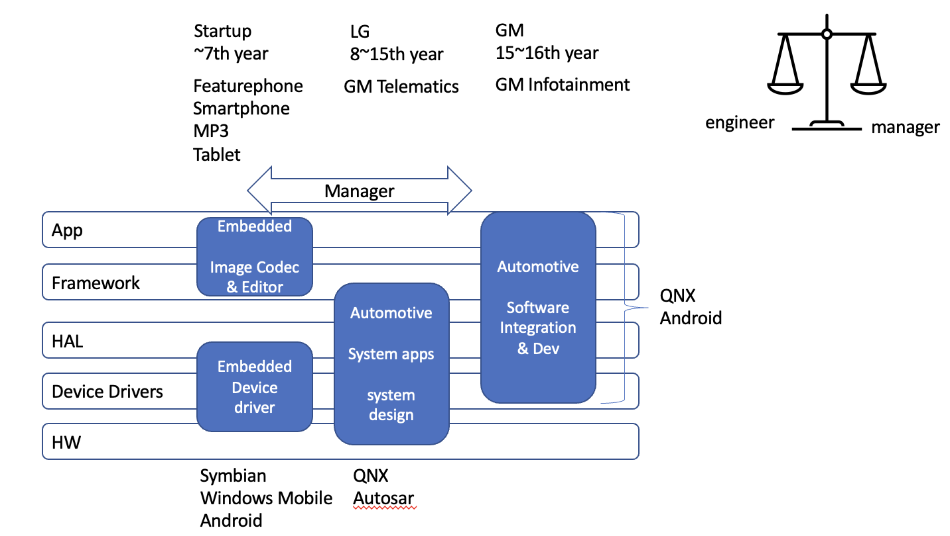
Ice breaking

Slide 3
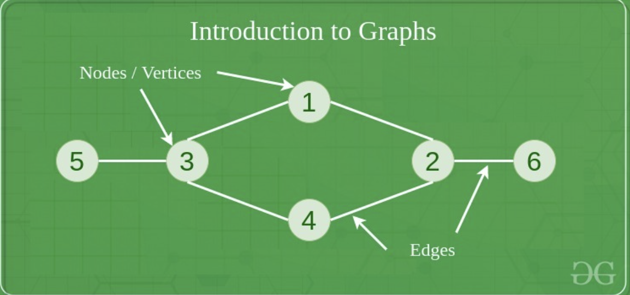
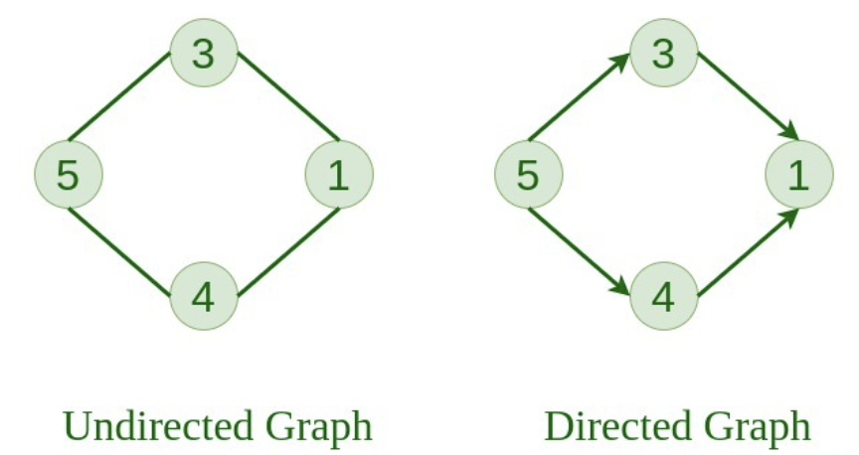
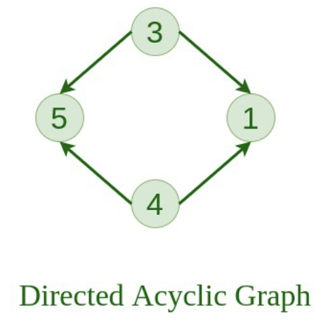
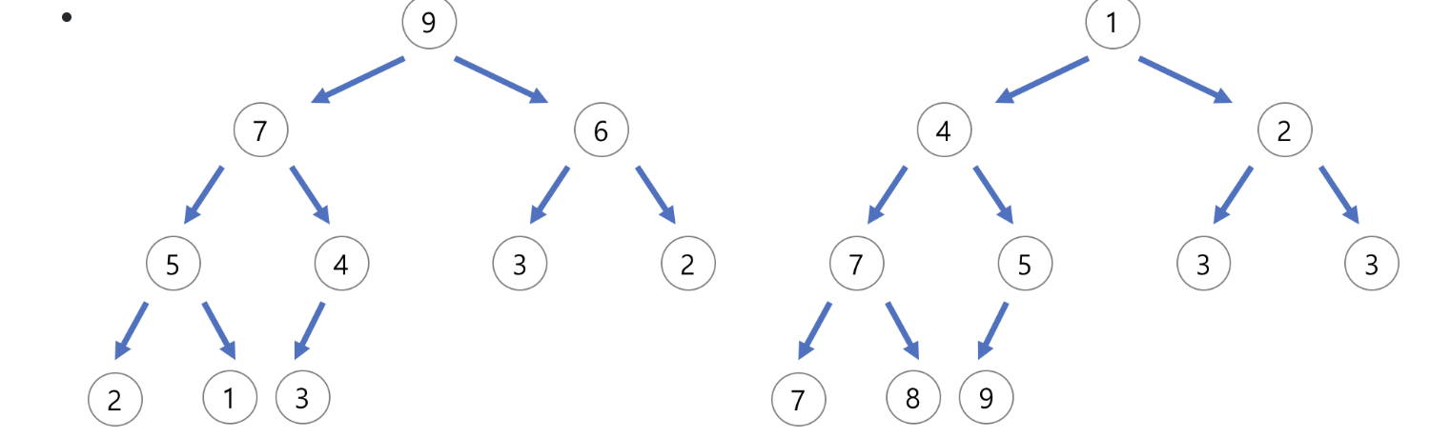
Recap Basics
Linear vs Non-Linear
Vertices, Nodes, and Edges
Directed vs Undirected
Cyclic vs Acyclic
Graph vs Tree(Hierarchical)
Linked list, Tree, and Heap(Complete Queue)
Operations
Search, insert, delete and Traverse

Slide 4
Google guideline for graph
Explain – Clarify – Improve - Practice
Consider if a problem can be applied with graph algorithms like distance, search, connectivity, cycle detection, etc.
There are three basic ways to represent a graph in memory (objects and pointers, matrix, and adjacency list)
familiarize yourself with each representation and its pros and cons.
You should know the basic graph traversal algorithms, breadth-first search and depth first search.
Know their computational complexity, their tradeoffs and how to implement them in real code.

Slide 5
When do we use graph?
Relationship, Network analysis (Transportation, Computer networks)
Data science in sports, Finding path
Data clustering (Hierarchical / K-means)
Not recommend for simple / structured and large size data set
Pros
Intuitive
Strong at representing a wide range of Relationship / Data structure
Path finding, data science, machine learning and etc
Cons
Complex and difficult to understand
Expensive for large set of data
Hard to extract meaningful data

Slide 6
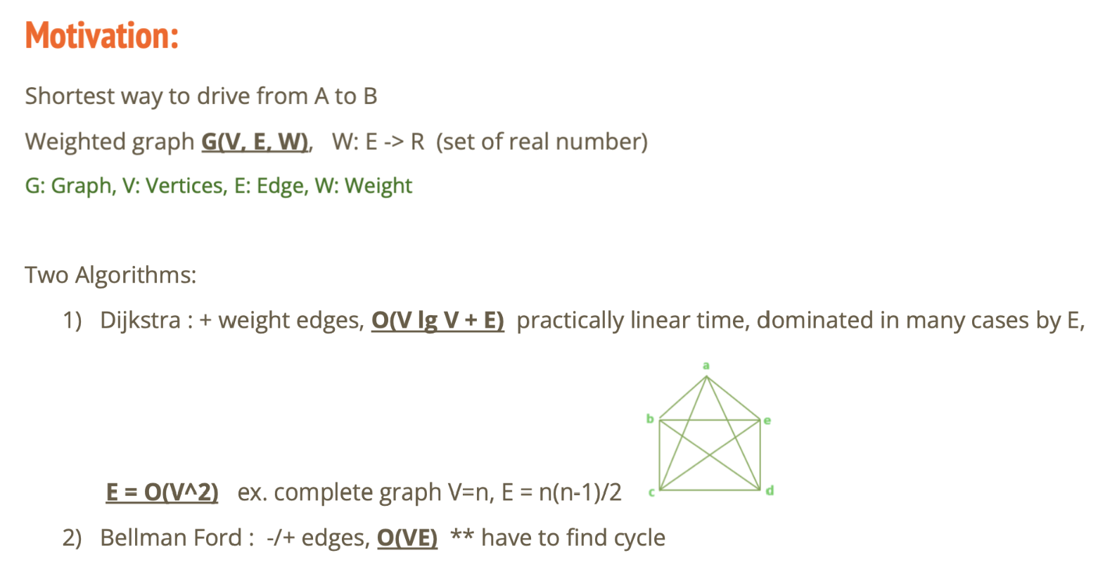

Slide 7
 | Dijkstra | Bellman Ford
Process | 1. Explore Vertex 2. Relaxation 3. Update estimates 4. Choose smallest dist among paths to new unexplored vertex 4. Do not revisit | Explore Vertex Relaxation all edges to current Vertex (only Outgoing edges from current) Updates smallest dist from all possible paths to new unexplored vertex Repeat N-1 to avoid cycle
Pros | Fast without negative edges | Good for graph negative edge Includes Dijkstra solution
Cons | May Fail to get shortest path | Slow May not use if negative edge doesn’t exist
Complexity | O(V^2) O(VlgV+E) with minheap(Priority Q) | O(VE) = Vertex x Edges Could be O(V²)
Example | LeetCode Network delay | LeetCode Network delay

Slide 8
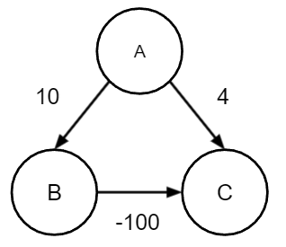
Problem with Dijkstra
[0, Infinite, Infinite]
A-B [0,10,Infinite]
A-C [0,10,4]
Not visit B-C

Slide 9
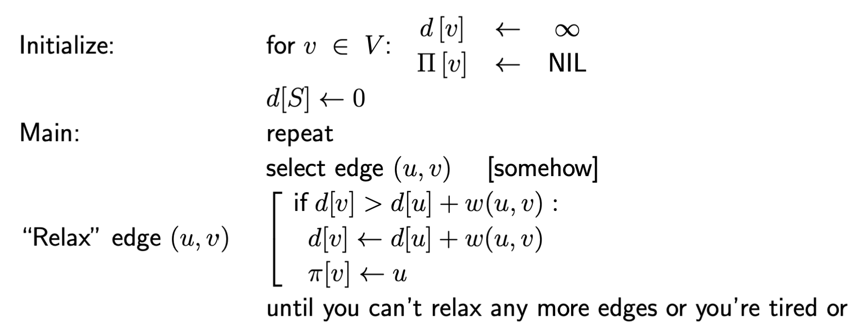
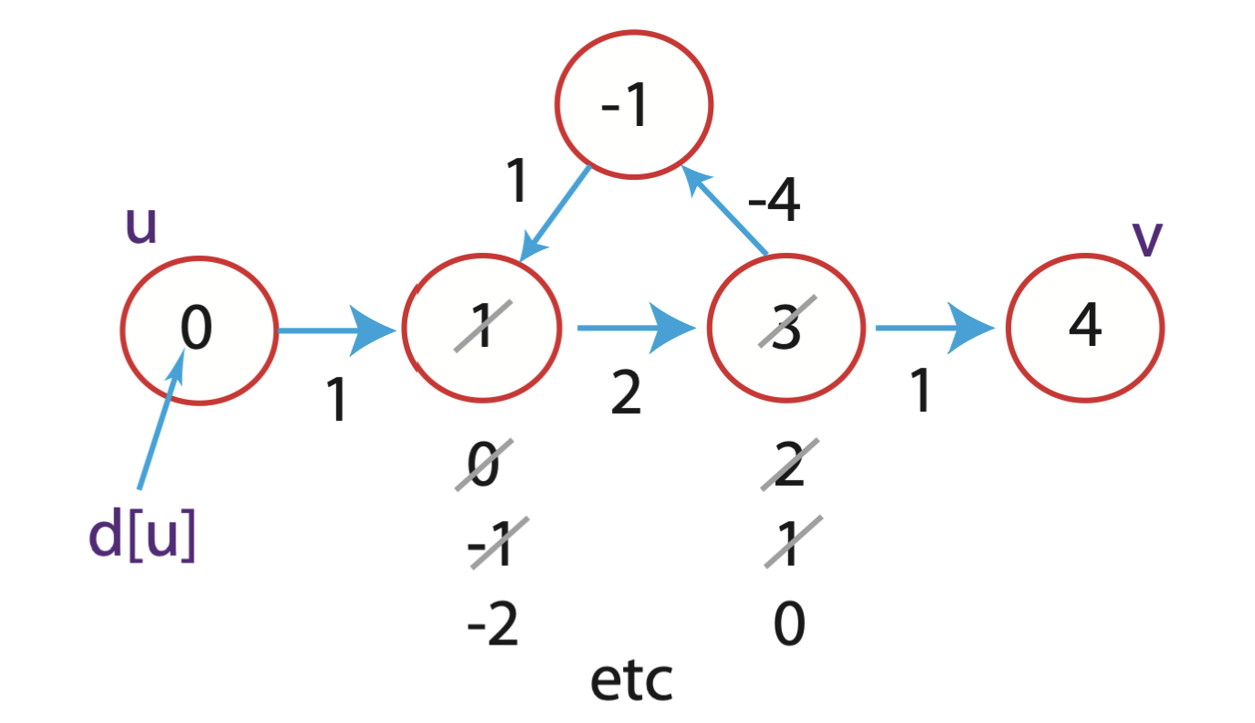
Problem of Generic S.P with negative edges
Exponential time (2^{2/n})
Fix with Dijkstra
Iteration will not be terminated with negative cycle
Fix with Bellman Ford

Slide 10
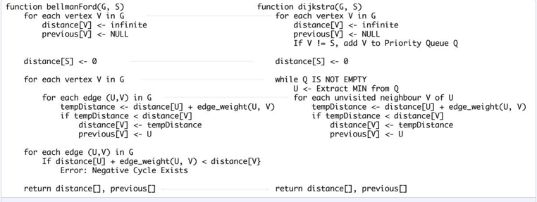
Code comparison Dijkstra vs Bellman
<- |V|-1

Slide 11
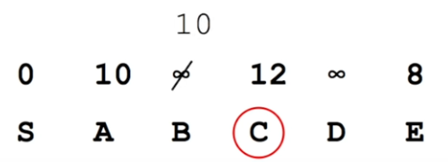
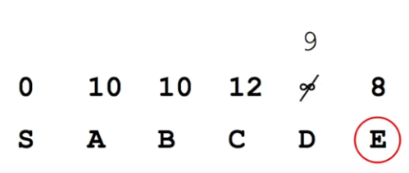
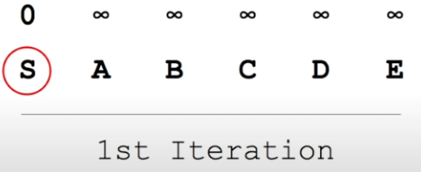
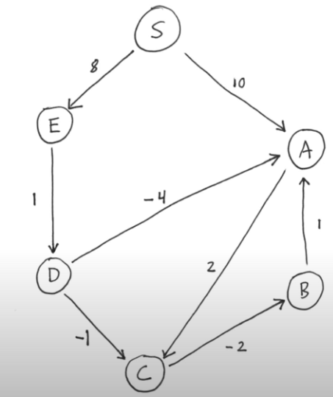
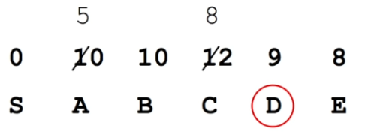
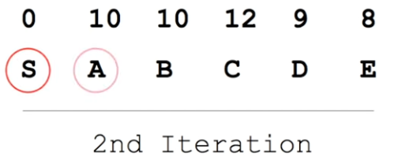
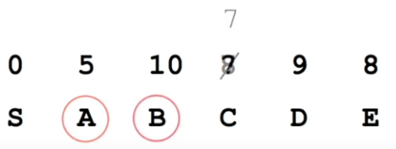
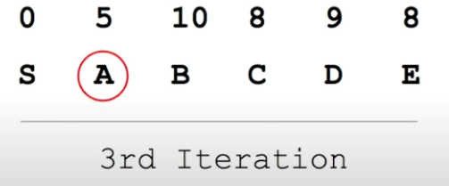
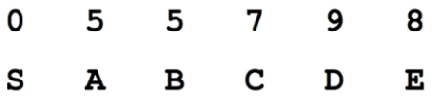
Bellman ford
6 Vertices
5 Iterations
4th & 5th Iteration

Slide 12
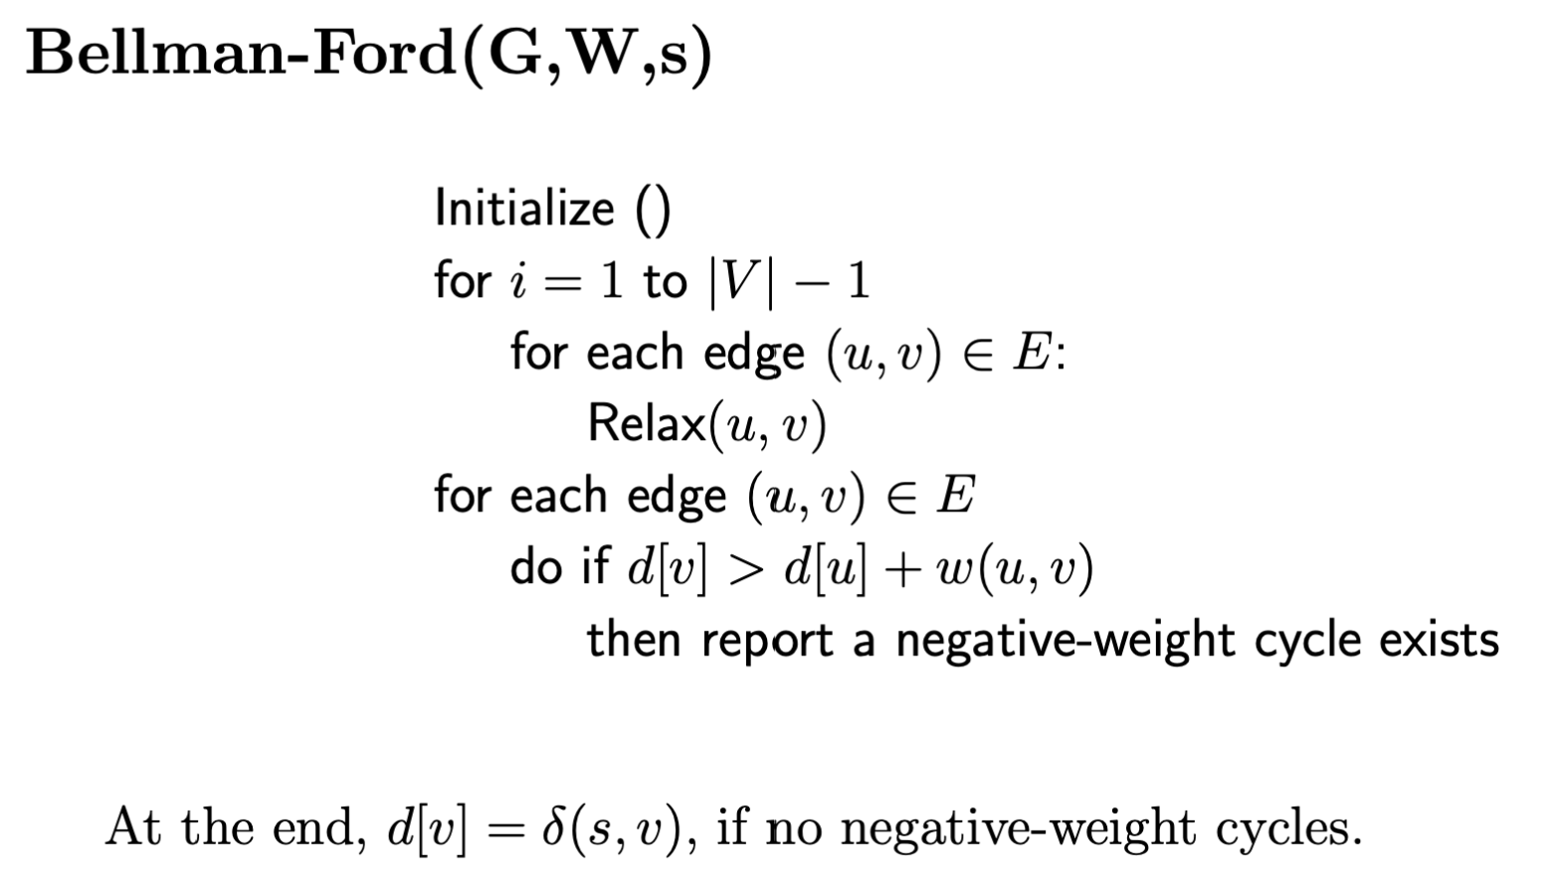
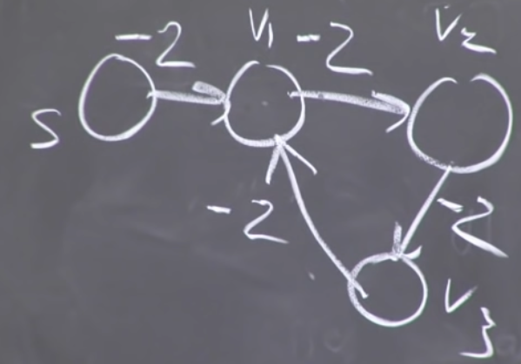
Negative weight cycle
Bellman ford will return undefined

Slide 13
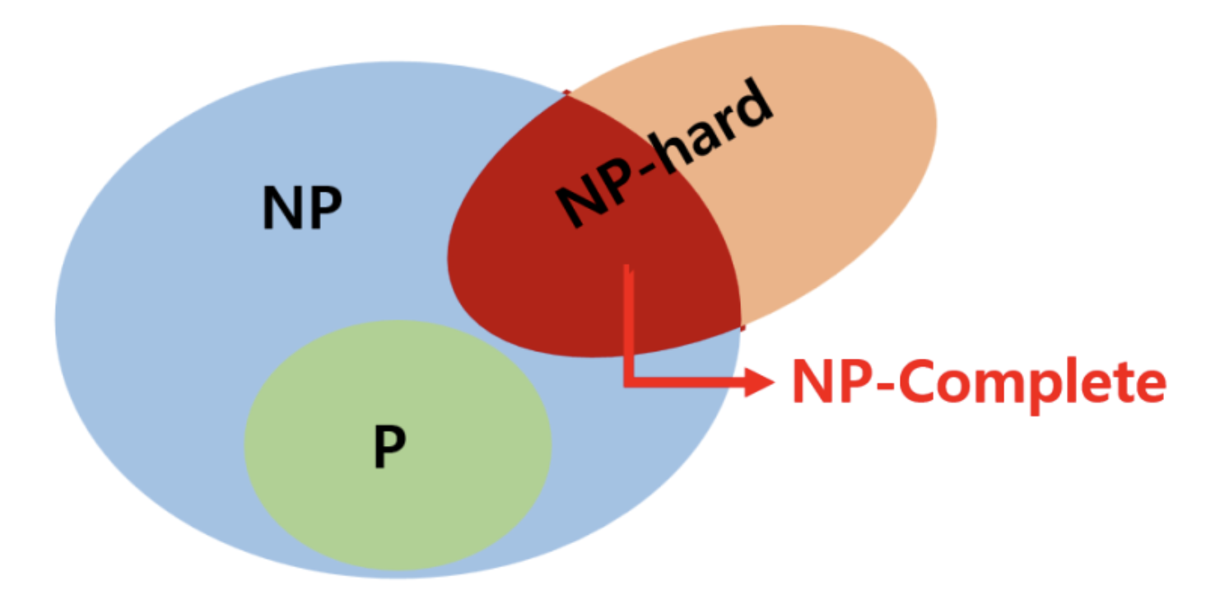
Appendix
P : Polynomial time & Yes or No
NP hard : NP-Hard problems(say X) can be solved if and only if there is a NP-Complete problem(say Y) that can be reducible into X in polynomial time.
NP-Complete problems can be solved by a non-deterministic Algorithm/Turing Machine in polynomial time.

Slide 14
Appendix
https://www.geeksforgeeks.org/
https://sskl660.tistory.com/59
https://github.com/arnab132/Bellman-Ford-Algorithm-Python
https://kangworld.tistory.com/76 (Dijkstra negative value)
https://www.geeksforgeeks.org/difference-between-np-hard-and-np-complete-problem/
https://www.youtube.com/watch?v=obWXjtg0L64

